Slide 1



Butterfly
Effect
P
H
P
Stands for:

Slide 2





Local & Global
F
P
H
P
We Will Learn :
Function
Local & Global
SuperGlobal
Post & Get

Slide 3







F
unction

Slide 4
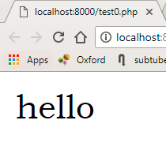


F
SayHello
unction

Slide 5
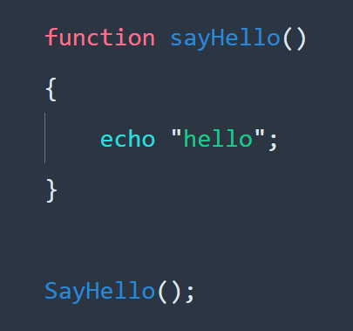

Slide 12
F
SayHelloTo
Hello Reem
Reem
unction

Slide 13

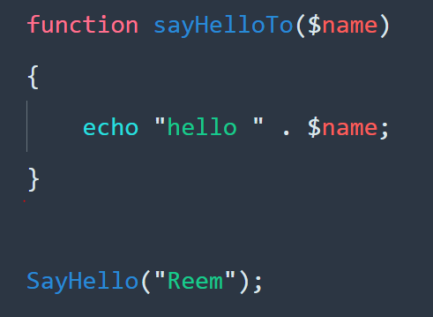
F
SayHelloTo
Hello Reem
Reem

Slide 18
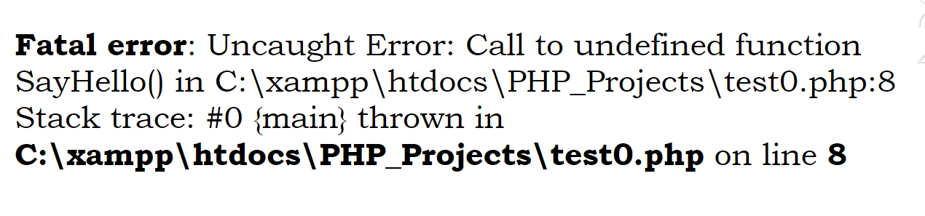

Slide 19


Slide 20
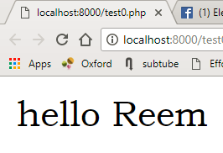

Slide 21
Sum
2
7
5
unction

Slide 22
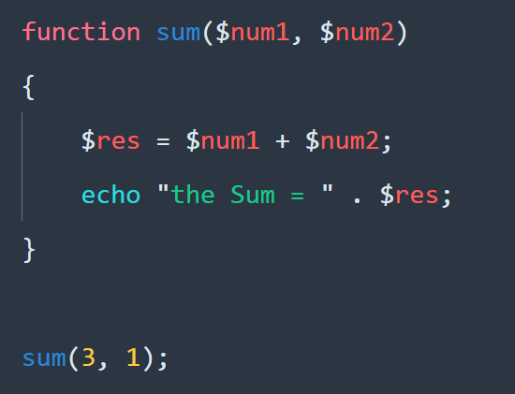

Slide 26
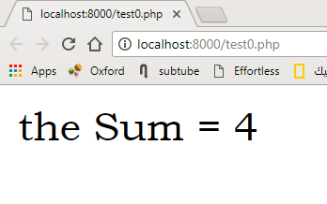

Slide 27


Slide 28
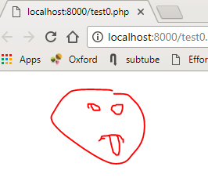

Slide 29
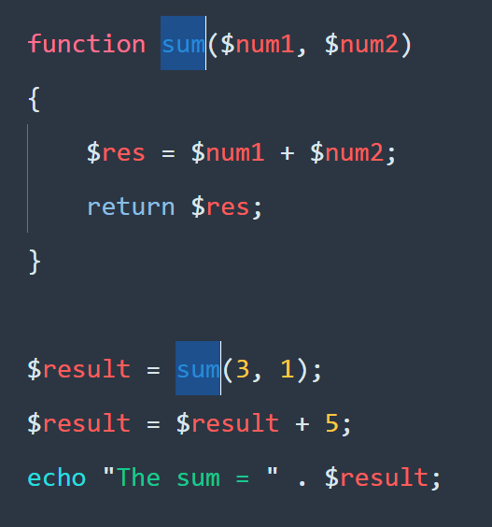

Slide 32
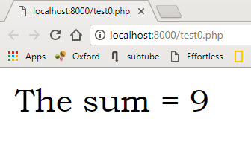

Slide 33

H
1
Quiz
P
P

Slide 34
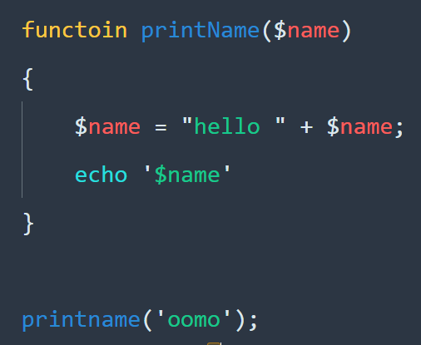
L

Slide 35
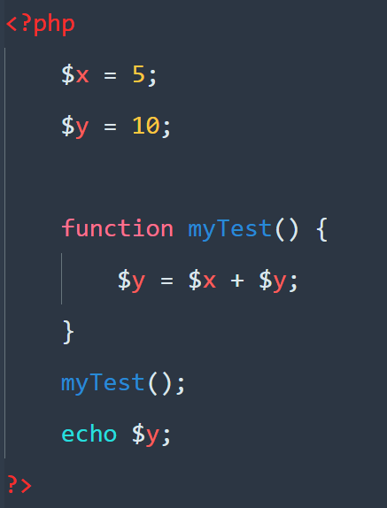
L
Ocal & global

Slide 36
L
Ocal & global

Slide 37
L
Ocal & global

Slide 38
L
Ocal & global

Slide 39
L
Ocal & global

Slide 40
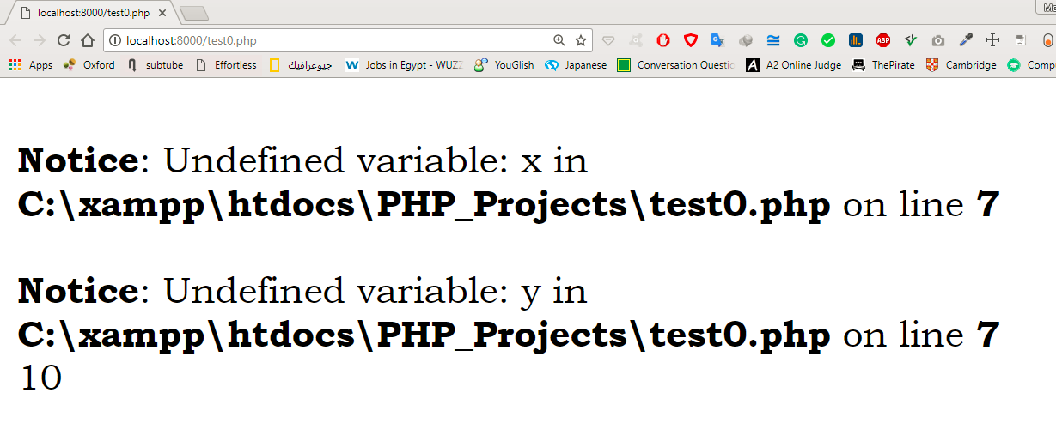

Slide 41
L
Global
Local
Ocal & global

Slide 42
global

Slide 43
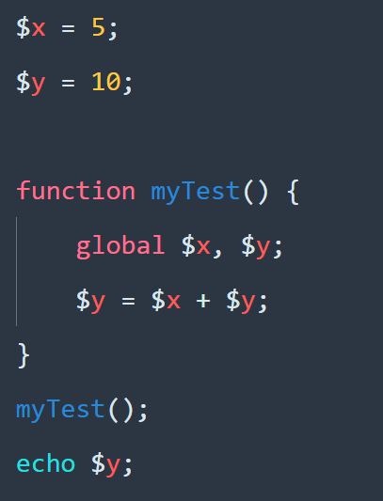

Slide 47
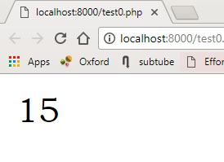
s
uperGlobal

Slide 48
s
uperGlobal

Slide 49


Super Global
Global

Slide 50
$GLOBALS[‘ .. ‘]

Slide 51
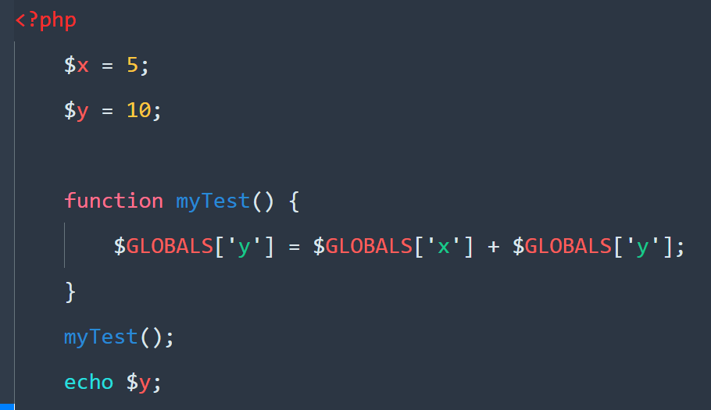

Slide 55
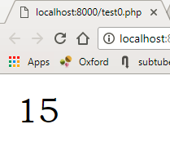

Slide 56
$_GET[‘ .. ‘]
$_POST[‘ .. ‘]

Slide 57
Username:
Password:
Phone Number:
Email:

Slide 58
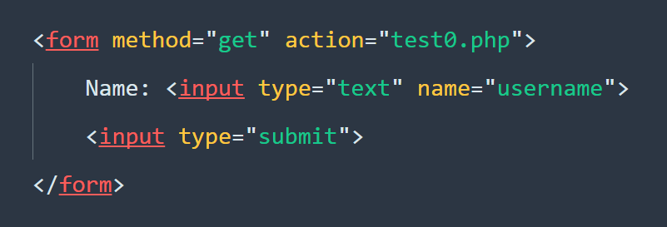

Slide 61
Difference
GET
POST

Slide 62
Difference
GET
POST

Slide 63

_EVR[‘ .. ]
$_SRVR[‘ . ]
Atom Time

Slide 64
$_SERVER[‘ .. ‘]

Slide 65
REQUEST_METHOD

Slide 66
_EVR[‘ .. ]
$_SRVR[‘ . ]
Atom Time

Slide 67
strln( tring )
strln( tring )
Username:
Password:
Phone Number:
Email:

Slide 68
H
strlen( String )
P
P

Slide 69
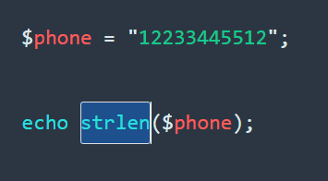
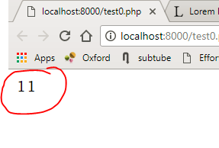
H
strlen( String )
P
P

Slide 70
H
P
P
str_replace( sub, sub, string )

Slide 71
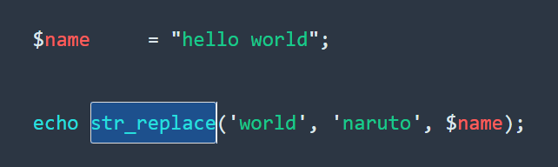
H
strlen( String )
P
P

Slide 72
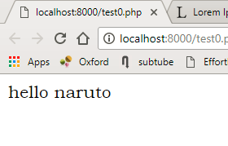
H
strlen( String )
P
P

Slide 73
Atom Time

Slide 74

The End

